Slide 1



Characteristics of complexes from the point of view of the theory of valence bonds. Chemical equilibrium in solutions.
Al-Farabi Kazakh National University
Faculty of Chemistry and Chemical technology
Department of General and Inorganic Chemistry
pHd Bakhadur askar

Slide 2

The valence bond theory (VBT)
The valence bond theory (VBT) explains the bonding and structure of coordination complexes in terms of overlap between metal orbitals and ligand donor orbitals.
Metal ions possess vacant orbitals that can accept electron pairs from ligands.
Ligands donate electron pairs through coordinate covalent bonds.
The geometry of the complex depends on hybridization of the central metal’s orbitals.
VBT connects classical valency concepts with quantum mechanics, providing a qualitative understanding of bond formation and molecular geometry in metal complexes.

Slide 3
Formation of complexes: the VBT approach
When a ligand approaches the central metal ion:
The metal ion accepts lone pair electrons from ligands into its vacant orbitals.
Hybrid orbitals form to minimize energy and maximize bond strength.
Each hybrid orbital overlaps with a ligand orbital containing a lone pair of electrons.
Example: In [Co(NH₃)₆]³⁺, Co³⁺ (3d⁶) uses its inner 3d, 4s, and 4p orbitals to form six d²sp³ hybrid orbitals, resulting in an octahedral geometry. Each hybrid orbital overlaps with the nitrogen lone pair of NH₃, forming strong coordinate bonds.

Slide 4
Magnetic properties and bond character
VBT also explains magnetic behavior and bonding type in coordination compounds.
Inner orbital complexes (low-spin): use inner d-orbitals; fewer unpaired electrons → diamagnetic. Example: [Co(NH₃)₆]³⁺ → all electrons paired.
Outer orbital complexes (high-spin): use outer d-orbitals; more unpaired electrons → paramagnetic. Example: [FeF₆]³⁻ → five unpaired electrons.
Thus, VBT successfully accounts for:
Geometry of the complex
Magnetic properties (paramagnetism, diamagnetism)
Qualitative stability based on bond overlap
However, it does not predict color or spectral properties, which are explained by Crystal Field Theory (CFT).

Slide 5
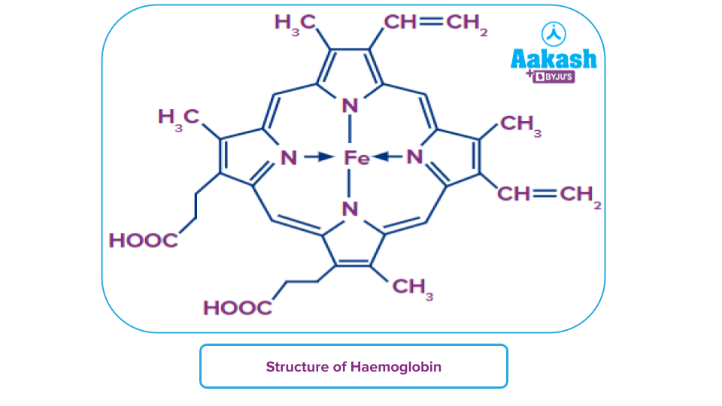
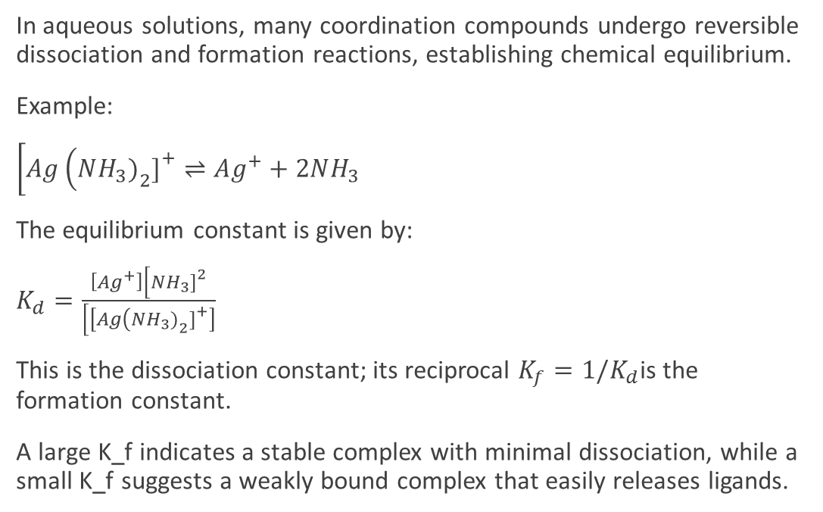
Chemical equilibrium in solutions
In aqueous solutions, many coordination compounds undergo reversible dissociation and formation reactions, establishing chemical equilibrium.
Example:
$\left[Ag\left(NH_{3}{\left.)\right.}_{2}{\left.]\right.}^{+}⇌Ag^{+}+2NH_{3}\right.\right.$
The equilibrium constant is given by:
$K_{d}=\frac{\left[Ag^{+}\right]\left[NH_{3}{\left.]\right.}^{2}\right.}{\left[\left[Ag\left(NH_{3}{\left.)\right.}_{2}{\left.]\right.}^{+}\right]\right.\right.}$
This is the dissociation constant; its reciprocal $K_{f}=1/K_{d}$is the formation constant.
A large K_f indicates a stable complex with minimal dissociation, while a small K_f suggests a weakly bound complex that easily releases ligands.

Slide 6

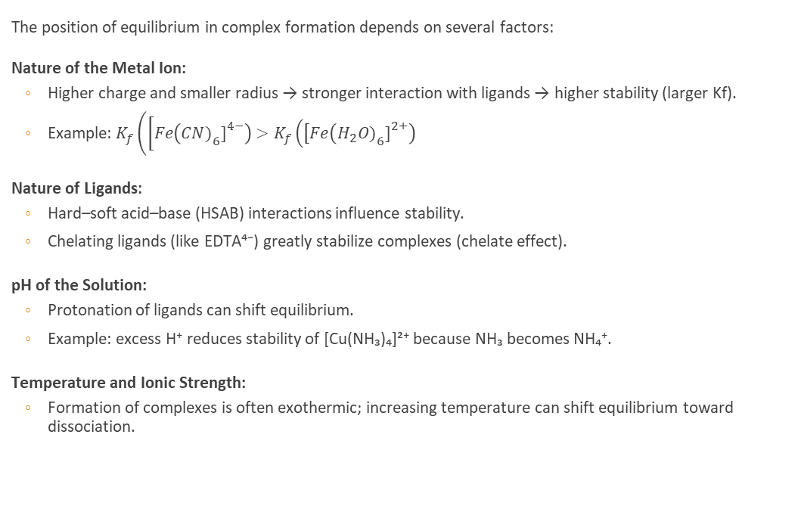
Factors Influencing Equilibrium
The position of equilibrium in complex formation depends on several factors:
Nature of the Metal Ion:
Higher charge and smaller radius → stronger interaction with ligands → higher stability (larger Kf).
Example: $K_{f}\left(\left[Fe\left(CN{\left.)\right.}_{6}{\left.]\right.}^{4−}\right)>K_{f}\left(\left[Fe\left(H_{2}O{\left.)\right.}_{6}{\left.]\right.}^{2+}\right)\right.\right.\right.\right.$
Nature of Ligands:
Hard–soft acid–base (HSAB) interactions influence stability.
Chelating ligands (like EDTA⁴⁻) greatly stabilize complexes (chelate effect).
pH of the Solution:
Protonation of ligands can shift equilibrium.
Example: excess H⁺ reduces stability of [Cu(NH₃)₄]²⁺ because NH₃ becomes NH₄⁺.
Temperature and Ionic Strength:
Formation of complexes is often exothermic; increasing temperature can shift equilibrium toward dissociation.

Slide 7
Applications of VBT and equilibrium concepts
Understanding valence bond theory and solution equilibrium has practical importance:
Analytical Chemistry: Metal-ligand equilibria used in titration indicators and complexometric analysis (EDTA titrations).
Medicinal Chemistry: Drug-metal complex stability determines bioavailability (e.g., cisplatin–DNA interactions).
Environmental Chemistry: Complexation affects solubility and mobility of metal ions in natural waters.
Industrial Chemistry: Control of complex equilibria is crucial in electroplating, catalysis, and water treatment.
These principles enable prediction, control, and manipulation of chemical reactions in solution.

Slide 8
Summary
Valence Bond Theory (VBT) explains metal–ligand bonding through orbital hybridization and electron-pair donation.
The geometry and magnetism of complexes depend on the hybrid orbitals involved.
In aqueous media, complexes participate in dynamic equilibria described by formation (Kf) and dissociation (Kd) constants.
Equilibrium shifts depend on metal ion charge, ligand type, pH, and temperature.
Knowledge of both bonding and solution equilibrium provides a unified understanding of complex chemistry.
The valence bond approach reveals how the structure and bonding of coordination compounds govern their chemical behavior in solution. Coupled with equilibrium theory, it enables chemists to predict the formation, stability, and reactivity of metal complexes across chemical, biological, and industrial systems.

Slide 9

Questions?

